Slide 1

IMAGINE
Providing support for your loved one with schizophrenia

Slide 2
Introduction to Schizophrenia
Module 1

Slide 3


Is it Schizophrenia?
Sometimes it is Hard to Tell
It may be difficult to tell what caused a first episode of psychosis — there are many possible causes
It may take some time to
make a diagnosis
Doctors and other healthcare professionals are not trying to hide anything; they want to be sure of the cause before making the diagnosis
Source:
Schizophrenia Society of Alberta www.schizophrenia.ab.ca

Slide 4
What is Schizophrenia?
Schizophrenia
Affects about 1 in every 100 people
Is an extremely complex mental illness
Is difficult to distinguish from other mental health problems and make a diagnosis
Can cause a number of different changes in a person's thoughts, feelings and behaviour
Is believed to be caused by an imbalance
of the brain's natural chemicals
Is treatable with psychotherapy and
medication
Sources:
Schizophrenia Society of Alberta www.schizophrenia.ab.ca

Slide 5

What is Psychosis?
Psychosis:
A loss of contact with reality
People have trouble distinguishing
between what is real
and what is not
When this occurs, it is
called a psychotic episode.
Some causes include:
  Mental illness (e.g., schizophrenia,
  bipolar disorder)
  Brain injury
  Infection
  Substance abuse
Source:
Schizophrenia Society of Alberta www.schizophrenia.ab.ca

Slide 6
Key Symptoms of Psychosis
Definitions
Delusions occur when someone believes ideas that are clearly false
  e.g., people are reading their thoughts or they can control other people's minds
Hallucinations cause a person to hear voices inside or outside their heads or, less commonly, see things that do not exist
Source:
Schizophrenia Society of Canada. www.schizophrenia.ca/

Slide 7
Understanding the Symptoms of Schizophrenia
Positive Symptoms
Negative Symptoms
Symptoms that are present in the person with schizophrenia that were not seen when the person was healthy
  Delusions
  Hallucinations
  Disorganized thoughts, moods and/or behaviour
  Changes in sensitivity towards others (e.g., more sensitive and aware of other people, or withdrawn from others)
Symptoms that involve a loss of normal emotional responses or of other thought processes, e.g.:
  Lack of/less energy
  Change in physical activity level (usually a slowing)
  Reduced motivation
  Lack/loss of interest in the feelings and lives of others
  Lack of/less concern for personal appearance
Source
Schizophrenia Society of Alberta www.schizophrenia.ab.ca

Slide 8

Understanding Lack of Insight
Try to recognize that your loved one:
May not believe he/she is sick
May not seek medical help on his/her own
He/she may not see the need for medication or other mental health help
(refuse it initially or stop treatment)
May need to be assessed, hospitalized or treated involuntarily (against his/her will)
People with schizophrenia sometimes lack insight into their illness (sometimes referred to as anosognosia)
Sources:
Schizophrenia Society of Alberta www.schizophrenia.ab.ca
Schizophrenia Society of Canada. Learning About Schizophrenia: Rays of Hope. 2012.

Slide 9

Schizophrenia is Not the Same for Everyone
  Schizophrenia has been described as many illnesses masquerading as one
  Every person is affected differently
  Different symptoms
  Different severity
  Different responses to different treatments
  Different timing of symptoms
  (problems coming and going at different intervals)
Source:
Schizophrenia Society of Alberta www.schizophrenia.ab.ca

Slide 10
What Can We Expect When My Loved One Has an Episode?
Beginning
(prodromal phase)
Active illness
(psychotic episode)
Residual phase
Loss of interest in usual activities
Withdrawal from friends and family
Confusion
Trouble concentrating
Feeling listless and apathetic
Prefer to spend most of their days alone
Preoccupation with religion or philosophy
Continuation of prodromal symptoms, plus...
Delusions
Hallucinations
Marked distortions in thinking
Disturbances in behaviour and feelings
May be similar to the prodromal phase:
Listlessness
Trouble concentrating
Withdrawal
Source: Centre for Addiction and Mental Health: www.camh.ca/

Slide 11

Schizophrenia Over Time:
Each Person's Journey is Unique
Some only experience one episode in their lifetime while others experience many
Some experience long periods of wellness between psychotic episodes while others may experience psychotic episodes
that last a long time
Some people experience a psychotic episode without warning while others experience many early warning signs
Source:
Schizophrenia Society of Alberta www.schizophrenia.ab.ca

Slide 12

What is the Outlook for a Person with Schizophrenia?
Most people with schizophrenia can be treated, lead a productive life and be integrated in society
Schizophrenia is a chronic illness - most people will require various levels of treatment for most of their lives
Out of every 10 people with schizophrenia:
  3 recover quite well and are eventually able to resume their previous level of functioning
  3 recover to a lesser extent, but are
  usually able to live independently
  3 require extensive help, such as living in
  supportive housing or in a care facility
  1 does not survive schizophrenia,
  usually due to suicide
Source:
Schizophrenia Society of Alberta www.schizophrenia.ab.ca

Slide 13
What Does Treatment Include for People with Schizophrenia?
Psychiatric treatment
e.g., medication,
hospital-based care, care by a psychiatrist, etc.
Community services
e.g., counselling, community-based mental health care services and programs, peer support programs, etc.
Social support
e.g., housing, income, employment support, etc.
Source:
Schizophrenia Society of Alberta www.schizophrenia.ab.ca

Slide 14
Family Support is Crucial for People with Schizophrenia
Families are important partners in the treatment of schizophrenia
They play critical roles in supporting the person
living with schizophrenia on a daily basis:
  Providing stability
  Helping with activities of daily living
  Providing social interaction
  Promoting safety
  Helping with treatment
  (medication adherence, keeping appointments, etc.)
Sources:
Schizophrenia Society of Alberta www.schizophrenia.ab.ca
Schizophrenia Society of Canada. Learning About Schizophrenia: Rays of Hope. 2012.

Slide 15
Summary:
Be Realistic, But Not Pessimistic
Schizophrenia is a serious illness, this needs to be acknowledged and accepted
The way the disease affects people is different for everybody
People with schizophrenia often lack insight into their own disease and health
With proper treatment and support, many people with the disease can achieve a good quality of life and be productive members of families and of society

Slide 16
Educate Yourself:
Trusted Resources to Learn More About Schizophrenia
Schizophrenia Society of Alberta (www.schizophrenia.ab.ca)
Schizophrenia Society of Canada (www.schizophrenia.ca)
Canadian Mental Health Association (www.cmha.ca)
Mental Health Commission of Canada (www.mentalhealthcommission.ca)
Health Canada (www.hc-sc.gc.ca)
National Alliance on Mental Illness (USA) (www.nami.org)
Schizophrenia and Related Disorders Alliance of America (www.sardaa.org)

Slide 17

www.schizophrenia.ab.ca

Slide 18

Discussion
Group sharing of insights, questions and answers

Slide 19
Treating Schizophrenia
Module 2

Slide 20


Treating Schizophrenia:
Embracing the Hope for Recovery
Recovery is possible
The right treatment
strategy can help people with schizophrenia get their lives back and live their lives to the fullest

Slide 21
What Are the Key Goals of Schizophrenia Treatment?
Achieve and maintain remission from symptoms
Achieve functional recovery
Improve quality of life
Prevent relapses
Prevent progression of the disease
Sources:
Canadian Psychiatric Association. Clinical Practice Guidelines: Treatment of Schizophrenia. Can J Psychiatry 2005; 50(1):1S-56S.
American Psychiatric Association. Practice Guideline for the Treatment of Patients With Schizophrenia, Second Edition, 2010.

Slide 22
Where are People with Schizophrenia Usually Treated?
Treatment settings vary from person to person and at different stages of the disease
First episode
Stabilization
Relapse(s)
Period of disease
Hospital
admission
Outpatient psychiatry clinic
Primary care
Treatment setting
Source: Schizophrenia Society of Canada. Learning About Schizophrenia: Rays of Hope. 2012.

Slide 23
It Takes a Team Effort:
Possible Members of the Treatment Team
Primary care provider
(family doctor / nurse practitioner)
Friends
Psychiatrist
Person with schizophrenia
Family
Counsellor
Social worker
Support groups
Pharmacist

Slide 24
The Importance of Early
Treatment for Schizophrenia
The sooner a psychotic episode is appropriately treated, the better the potential outcomes
  More rapid and more complete recovery
  Fewer biologic abnormalities
  Fewer relapses
  Overall better long-term outcomes and cognition
No proper medical care
Proper medical care
The disease worsens
Recovery is possible!
Source: Schizophrenia Society of Canada. Learning About Schizophrenia: Rays of Hope. 2012.

Slide 25
Importance of Avoiding Relapses
Relapses (re-emergence of symptoms) are associated with
More
hospitalizations
Worsening function over time
Greater chance of future relapses
Damage to the brain
Relapses
Greater chance of stopping medication
Reduced ability to maintain a job and personal relationships
Less chance that medications will work as well
Sources:
Lieberman J et al. Biol Psychiatry 2001; 49(6):487-99; Brissos S et al. Schizophr Res 2011; 129(2-3):133-6; Almond S et al. Br J Psychiatry 2004; 184:346-51.
Emsley R et al. Schizophr Res 2012; 138(1):29-34; Nasrallah HA, et al. J Psychopharmacol 2006; 20(6 suppl):57-61.

Slide 26
Psychosocial Treatments for Schizophrenia
Treatments | Goals
Cognitive-behavioural therapy (CBT) | Helping people develop skills and strategies for becoming and staying healthy
Cognitive remediation | Using training and practice to improve memory and attention
Psychoeducation | Helping people understand the causes of their illness and the various treatment strategies for it
Social skills and life skills training | Learning communication skills to help reduce stress and risk of relapse
Family support and education and family counselling | Helping family members develop effective ways of coping Helping to understand recovery and its process Improving communication skills Providing relapse prevention strategies, including the identification of early warning signs Providing stress management training Suggesting ways of supporting each other in times of crisis
Sources: Centre for Addiction and Mental Health: www.camh.ca/; Schizophrenia Society of British Columbia: www.bcss.org/
Schizophrenia Society of Canada. Learning About Schizophrenia: Rays of Hope. 2012.
Notes:
Emphasize that family members can learn about, support and reinforce the new skills and strategies patients learn through their psychosocial treatments.

Slide 27
The Importance of Healthy Living for People with Schizophrenia
Regular exercise (at least three times per week) can:
  Make one feel more energetic
  and more relaxed
  Improve mood and outlook
  Reduce stress
  Be a natural way to meet people
  Help prevent other health
  problems (e.g., obesity, heart disease)
Proper nutrition is also essential for the well-being of a person with schizophrenia
Source: Schizophrenia Society of Canada. Learning About Schizophrenia: Rays of Hope. 2012.

Slide 28

Medication for Schizophrenia:
An Overview
Medications for schizophrenia are called antipsychotics
There is no such thing as a miracle pill that helps all patients
  Effects of medication vary greatly from
  individual to individual
  Finding the right treatment for each person
  is usually a trial-and-error process
  Often involves a number of attempts and
  adjustments before the right treatment is found
People with schizophrenia often require extensive support to keep taking their medication
Source: Schizophrenia Society of Canada. Learning About Schizophrenia: Rays of Hope. 2012.

Slide 29
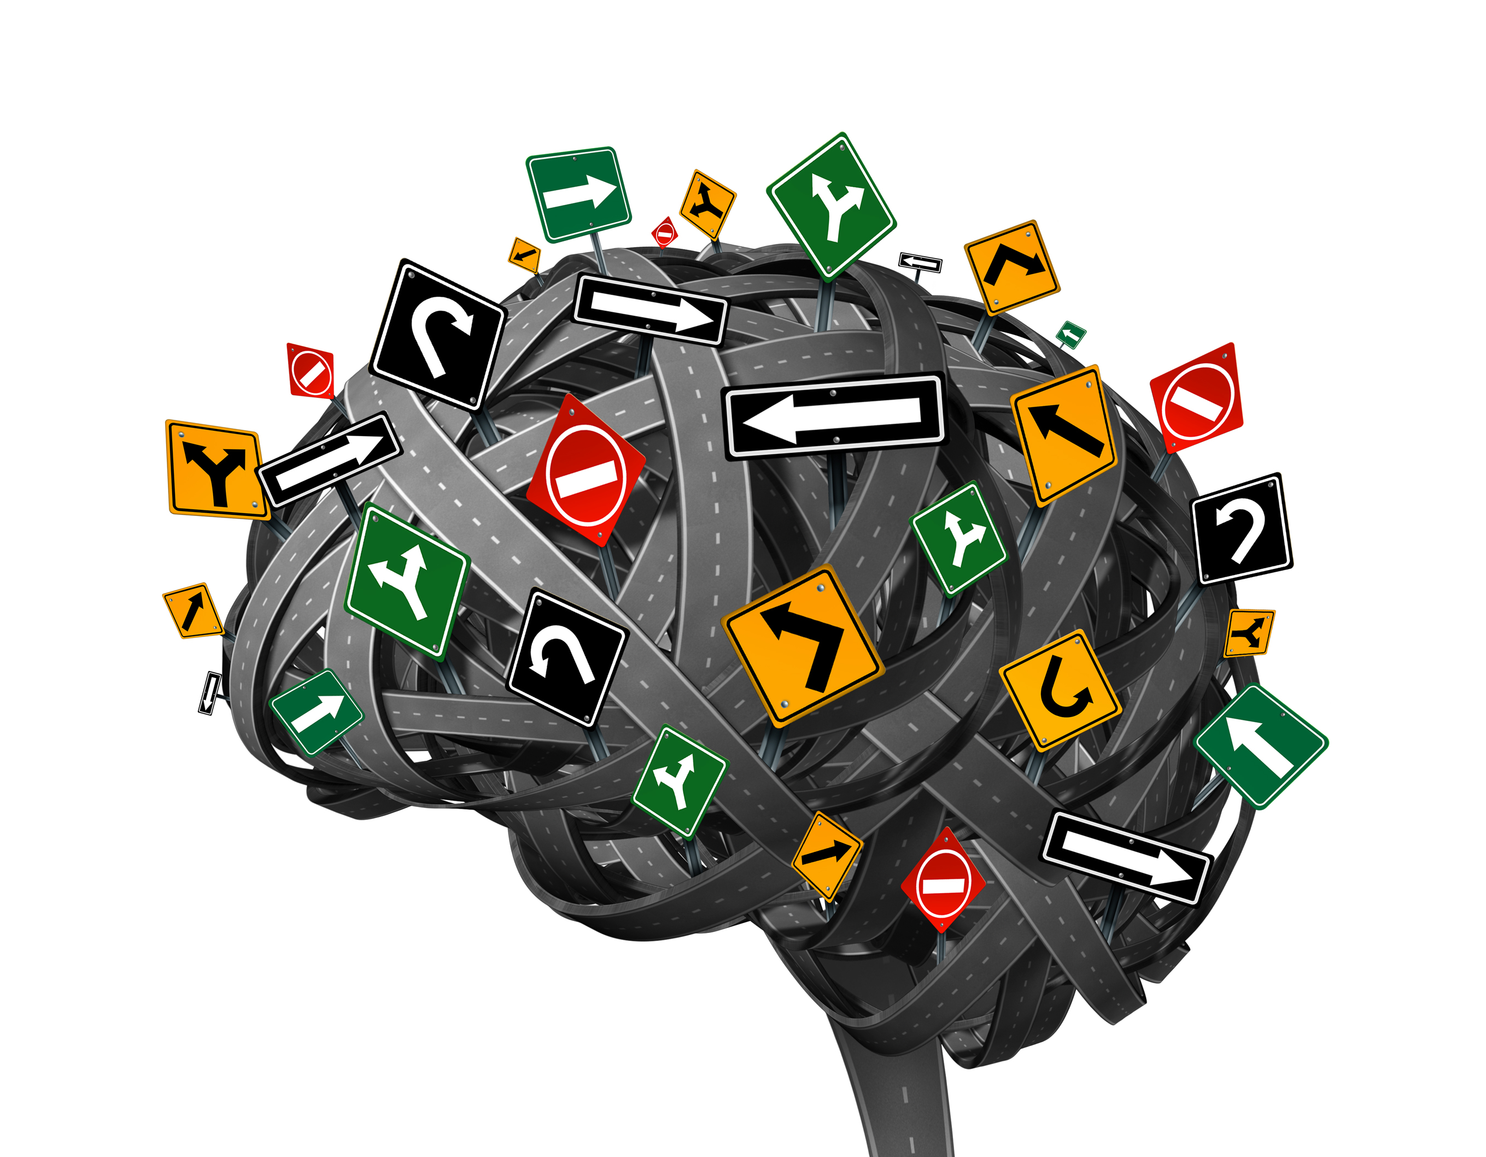
How Do Antipsychotics Work?
Messages in our brains are sent by chemicals called neurotransmitters
In schizophrenia, it is thought that something goes
wrong with this complex communication system
Antipsychotics work by helping to rebalance the
communication system
Each medication has different effects on the various neurotransmitters and every person's own neurotransmitter system is unique
  Medicines that work for one person may not work for another
Antipsychotics need to be taken correctly
and consistently to provide the most benefit
Source: Schizophrenia Society of Alberta www.schizophrenia.ab.ca

Slide 30
Understanding The Different
Types of Antipsychotics
First-generation
("Typical")
Second-generation ("Atypical")
Been available for more than
50 years
Less frequently used
Examples:
  Fluanxol® (flupenthixol)
  Haldol® (haloperidol)
  Largactil® (chlorpromazine)
  Modecate® (fluphenazine)
Developed more recently
Usually the preferred options
Examples:
  Abilify® (aripiprazole)
  Clozaril® (clozapine)
  Invega® (paliperidone)
  Risperdal® (risperidone)
  Seroquel® (quetiapine)
Source: Schizophrenia Society of Canada. Learning About Schizophrenia: Rays of Hope. 2012.

Slide 31
Antipsychotic Treatment:
Pill or Injection?
Antipsychotics are available as pills or injections
Choosing the method that best suits each person is an individual decision between the patient, the family and the healthcare team
Some considerations:
  The effectiveness of the medications in relieving symptoms, promoting remission is roughly similar
  Either can be used at any point in the disease course (e.g., first-episode, later)
  Long-acting injections may be preferred by some people, including those who have difficulty taking medicine on a daily basis
Source: Schizophrenia Society of Canada. Learning About Schizophrenia: Rays of Hope. 2012.

Slide 32
Antipsychotic Treatment:
How Often Is Medication Given?
Different antipsychotics have different dosing schedules
  Pills need to be taken every day (either once or twice daily) to keep working effectively
  Some injectable medications last much longer and only need to be given once every 2 weeks, 3 weeks or every month
Source: Schizophrenia Society of Canada. Learning About Schizophrenia: Rays of Hope. 2012.

Slide 33
Expectations for Treatment with Antipsychotics
  Out of every 10 people with schizophrenia treated with antipsychotic medication...
  ... 6 or 7 will experience substantial improvement
  3 or 4 will not, but they may respond
  to a different antipsychotic
Of those who experience substantial improvement...
  About half will experience a full
  remission of positive symptoms
  The other half may still have some positive symptoms
  despite taking the medication as directed
Source: Schizophrenia Society of Canada. Learning About Schizophrenia: Rays of Hope. 2012.
Notes:
Most antipsychotic medicines produce substantial improvement in about two-thirds of people who have a psychotic episode. Of these, about half experience a full remission of symptoms. The other half experience substantial improvements, but some symptoms are still present even though they faithfully take their medicine. Unfortunately the remaining third fail to respond to a particular medicine—in this case, the physician will try a different antipsychotic. Many individuals in this group will successfully respond to a subsequent medicine, even if the first one didn’t work.

Slide 34
Considerations for
Partial Response
Every person (and family) will have different expectations for treatment—these may not naturally align with those of the treatment team
  Communication is the key to ensure that the goals align
If the person with schizophrenia (or the family) is not satisfied with the degree of response, discuss other options (e.g., treatment switch) with the healthcare team

Slide 35
Setting Up A Wellness Plan For People in Remission
Elements to include:
Pertinent information accessible in one place
  Healthcare team information
  Diagnosis, other medical information
  Safety considerations if any
Record of self-perception and plans for wellness – to consult and to help recognize changes suggesting relapse
  Description of self when feeling well
  Record of things that keep him/her happy and healthy
  Description of what if feels like to be unwell or upset
  Record of things, that cause him/her to feel badly or upset?
  Ways to help when he/she is feeling badly or upset (e.g., family support)
You can use a hard copy (e.g., notebook) and/or electronic file (e.g., Word or Excel document)—whatever works best for you
  Medications
  Activities requiring assistance
  Life goals (including activities, interests)
Source: Schizophrenia Society of Alberta: Community Wellness Plan.

Slide 36
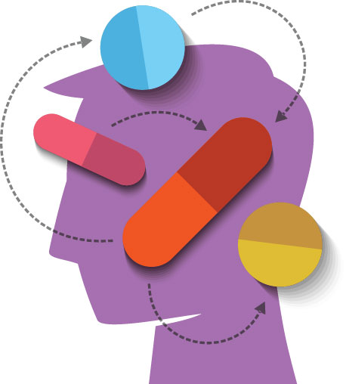
Learn About Side Effects:
The More You Know, the Better the Chances of Success
Unpleasant side effects can be distressing and can discourage patients from continuing to take their medication
Learn as much as possible about side effects to help prevent misunderstandings
Every medicine is different and every patient
can have a different experience with each
medicine
Read about side effects and talk about
them openly with the patient, and the
healthcare team
Source: Schizophrenia Society of Canada. Learning About Schizophrenia: Rays of Hope. 2012.

Slide 37
What About Alcohol,
Drugs and Smoking?
Drugs or alcohol can:
  Reduce the effectiveness of antipsychotic medication
  Lead to symptoms that are similar to symptoms of
  schizophrenia
People who smoke may need higher doses of medicine to control their illness
  People who change smoking habits may need to change the dose
Source: Schizophrenia Society of Canada. Learning About Schizophrenia: Rays of Hope. 2012.

Slide 38
Alternative Therapies and Schizophrenia
There is no solid evidence to support any alternative components such as, but not limited to, vitamins, supplements, herbal remedies for treatment of schizophrenia
Be sure to tell your healthcare team about any of these types of alternatives being considered or taken
  They are not necessarily harmless
  There is a possibility they could reduce the effectiveness of antipsychotic therapy

Slide 39
Embracing Hope, A Summary: Schizophrenia symptoms can be managed
In planning ongoing treatment and support for someone with schizophrenia, it is essential to have a strategy that integrates both pharmacological and psychosocial interventions
Antipsychotic medication is a critical component of successful treatment
Early treatment is associated with the best outcomes
To find the best option for each patient, trial-and-error is sometimes necessary

Slide 40
Educate Yourself:
Trusted Resources to Learn More About Schizophrenia
Schizophrenia Society of Alberta www.schizophrenia.ab.ca
Schizophrenia Society of Canada (www.schizophrenia.ca)
Canadian Mental Health Association (www.cmha.ca)
Mental Health Commission of Canada (www.mentalhealthcommission.ca)
Health Canada (www.hc-sc.gc.ca)
National Alliance on Mental Illness (USA) (www.nami.org)
Schizophrenia and Related Disorders Alliance of America (www.sardaa.org)

Slide 41

Your Local
Schizophrenia Society Branch
www.schizophrenia.ab.ca

Slide 42
Discussion
Group sharing of insights, questions and answers

Slide 43
Living With schizophrenia:
The Role of Family
Module 3

Slide 44
Family Support is Crucial for People with Schizophrenia
Families are important partners in the treatment of schizophrenia
They play critical roles in supporting the person
living with schizophrenia on a daily basis:
  Providing stability
  Helping with activities of daily living
  Providing social interaction
  Promoting safety
  Helping with treatment
  (medication adherence, keeping appointments, etc.)
Sources:
Centre for Addiction and Mental Health: www.camh.ca/
Schizophrenia Society of Canada. Learning About Schizophrenia: Rays of Hope. 2012.

Slide 45
Acknowledging the Disease
Family members need to acknowledge the illness and recognize the impact it will have on the patient and the rest of the family
  Living with any illness may change day-to-day lives for all
  There is no need to try to hide the reality; talking about it openly is helpful to all
Adjusting to schizophrenia may take some time, but it is very possible for people with schizophrenia and their families to lead full and enriching lives
Source: Schizophrenia Society of Ontario. www.schizophrenia.on.ca

Slide 46
Communication Tips for Family Members
People with mental illness... | So you need to...
have trouble with reality | be simple, truthful
are fearful | stay calm
are insecure | be accepting
have trouble concentrating | be brief, repeat
are over-stimulated | limit input, don't force discussion
easily become agitated | recognize agitation, allow escape
have poor judgment | not expect rational discussion
have changing emotions | disregard
have changing plans | keep to one plan
have little empathy for you | recognize as a symptom
believe delusions | ignore, don't argue
have low self-esteem | stay positive
are preoccupied | get attention first
are withdrawn | initiate relevant discussion
Source: National Alliance on Mental Illness (USA).—Yolo County Chapter.

Slide 47
Tips for Responding to Crisis Situations: A List of "Do"s
Try to remain as calm as possible
Decrease other distractions (e.g., turn off TV)
If other people are present, ask them to leave the room
Speak one at a time
Try saying, “Let’s sit down and talk,” or “Let’s sit down and be quiet.”
Speak slowly, clearly, in a normal voice
Make statements about the behaviour you are observing
Avoid patronizing, authoritative statements
Repeat questions or statements when necessary
Allow the person to have personal space
Understand that too much emotion on your part can upset him/ her further
Affirm or agree with the emotions the person is experiencing, without agreeing to the contents of the hallucination or delusion
Source: Schizophrenia Society of Canada. Learning About Schizophrenia: Rays of Hope. 2012.

Slide 48
Tips for Responding to Crisis Situations: A List of "Don'ts"
Don’t shout
Don’t criticize
Don’t challenge the person into acting out
Avoid continuous eye contact
Don’t block the doorway
Don’t rush
Don’t argue with other people about what to do
Source: Schizophrenia Society of Canada. Learning About Schizophrenia: Rays of Hope. 2012.

Slide 49

Understanding Confidentiality
Sharing health information is governed by provincial privacy laws
In some provinces, whatever is communicated between a patient and members of his/her healthcare team is confidential and cannot legally be disclosed to others (even family) without written permission from the ill person
In other provinces, information can be shared with third parties without a patient’s permission in certain circumstances
Patients can sign a formal document to
give the healthcare team the legal right
to breach confidentiality
  Healthcare professionals are trained to
  seek this at the earliest possible moment
  Family members can encourage loved ones
  to do this as soon as the person is well and
  cooperative enough to do so
Source: Coupland W. Confidentiality and mental health.

Slide 50
Family Members Can
Help Support Overall Health
People with mental health problems are at higher risk of developing other serious health problems
  Cigarette smoking
  High blood pressure
  High cholesterol
  Weight gain/obesity
  Type 2 diabetes
Family members can play a crucial role in promoting healthy lifestyle choices
  e.g., encourage and help achieve healthy diet, exercise, smoking cessation, discouraging alcohol & drug use

Slide 51
To Be Able to Help your Loved One, You Also Need to Take Care of Yourself!
Ways to Help Take Care of Yourself
Go for a walk or run
Practice meditation
Keep in touch with friends
Take a break; ask another
family member or hire
someone to provide care
Read a good book
Enjoy a pet
Go for a massage
Accept help
Let go of the need for
everything to go right
Delegate chores
Stay with a routine
Enjoy nature
Take up a hobby
Maintain a good diet
Set limits and keep time
for yourself
Celebrate the good times
Here To Help. Family Toolkit. www.heretohelp.bc.ca/

Slide 52
Remember That You Are
Part of a Team!
You are only one part of the support system — don't try to do it all yourself
Don’t hesitate to ask for help!
  Healthcare team
  Supporting peers
  Other family members, friends
  Professional associations, e.g.:
    Schizophrenia Society of Canada, provincial branches
    Canadian Mental Health Association
Notes:
Note to speaker: You may customize provincial branches to your own i.e. SSA etc.

Slide 53
Options for People and Families Who Need More Support: Community Treatment
Enrollment in a Community Treatment Program may help
Typical components:
  Regular physician meetings
  Regular meetings with a case manager
  Monitoring of medications
  Supported living environments
  Attendance at group therapy
  Skills training or other community activities
  Plans for potential crisis/psychiatric emergency
Source: Schizophrenia Society of Canada. Learning About Schizophrenia: Rays of Hope. 2012.

Slide 54
Involuntary Assessment, Hospitalization or Treatment
Family members, friends and/or healthcare professionals can request that a person with schizophrenia undergo psychiatric assessment, be hospitalized and/or treated involuntarily if he/she is believed to be a threat to him/herself or others
  Different official forms for different situations
  Regulated by provincial/territorial laws
Sources:
Schizophrenia Society of Canada. Learning About Schizophrenia: Rays of Hope. 2012.
Centre for Addiction and Mental Health: www.camh.ca/

Slide 55
Plan for the future

Slide 56
What Will Happen When I'm Not There to Help Anymore?
The primary caregiver for a person with schizophrenia is often a parent
Plans should be made in advance about ongoing care should the caregiver no longer be able to provide it, e.g.:
  Living arrangements
  Financial management
  Medical care
Another family member (e.g., sibling) may be willing to take on the responsibility
  If no other family members are willing/able, arrangements should be made with the healthcare team/public health system
Britchford C. Planning for the Future of a Loved One With Schizophrenia. www.everydayhealth.com/

Slide 57
Educate Yourself:
Trusted Resources to Learn More About Schizophrenia
Schizophrenia Society of Canada (www.schizophrenia.ca)
  Provincial branches
Canadian Mental Health Association (www.cmha.ca)
Mental Health Commission of Canada (www.mentalhealthcommission.ca)
Health Canada (www.hc-sc.gc.ca)
National Alliance on Mental Illness (USA) (www.nami.org)
Schizophrenia and Related Disorders Alliance of America (www.sardaa.org)

Slide 58
www.schizophrenia.ab.ca

Slide 59
Discussion
Group sharing of insights, questions and answers

